Slide 1
SCOPING STUDY MARCH 2020
IMAGINATION
CENTER at Reindahl Park
Joint Meeting of the Library Board and Board of Park Commissioners - March 11, 2020
Kevin Englebert, Library Planner

Slide 2
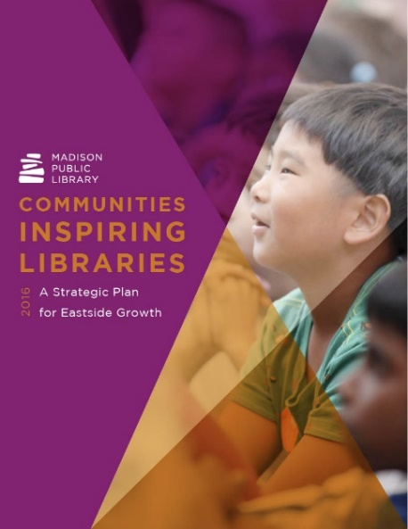
Imagination Center Background
In 2015, Madison Public Library launched the planning process for an eastside strategic plan
Library staff engaged 338 people through 52 conversations using Tell Us/Cuéntenos: Communities Inspiring Libraries
The eastside plan contains values and goals as well as a land use analysis of library locations and service
In 2016, the eastside plan was completed and adopted by the Library Board and Common Council

Slide 3
Communities Inspiring Libraries: A Strategic Plan for Eastside Growth
The primary recommendation of the eastside plan is to construct a new library in northeast Madison at Reindahl Park
The plan recognized other civic and social services are needed in northeast Madison
Madison Public Library created the Imagination Center concept, intentionally broad and open-ended to discover community needs

Slide 4
Scoping Study Goals
What is the Imagination Center and how will it impact Madison?
Who will be better off because of the Imagination Center?
How will the Imagination Center interact with Reindahl Park?
What does a successful Imagination Center look like?
The goal of the scoping study is to establish a community vision to guide the project through design, construction, and operation

Slide 5
Scoping Study Layout
Six Sections
History and Background
Neighborhoods
Demographics
Transportation
Engagement
Recommendations
Imagine Madison & Park and Open Space Plan
The Road Ahead

Slide 6
Reindahl Park

Slide 7
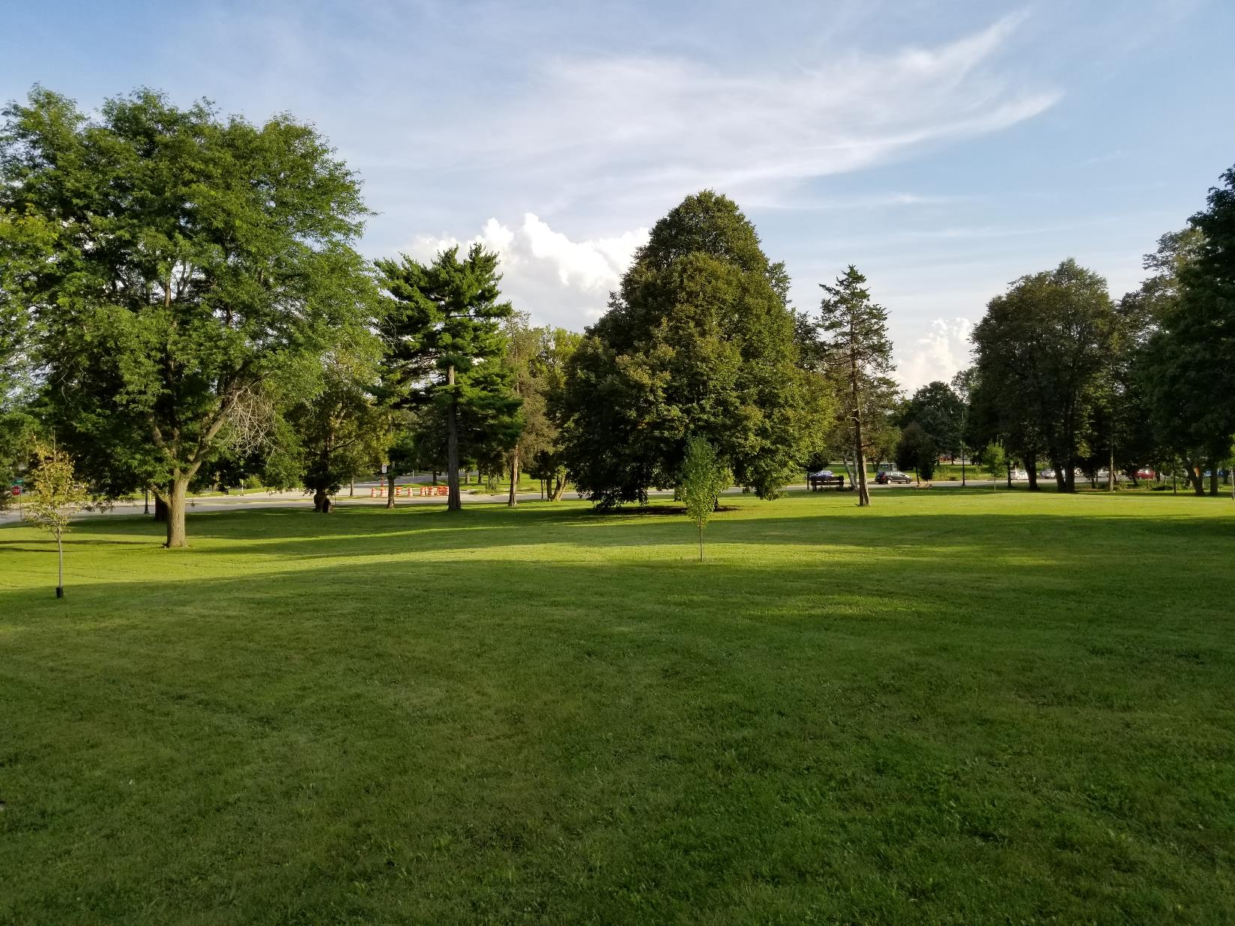

Slide 8
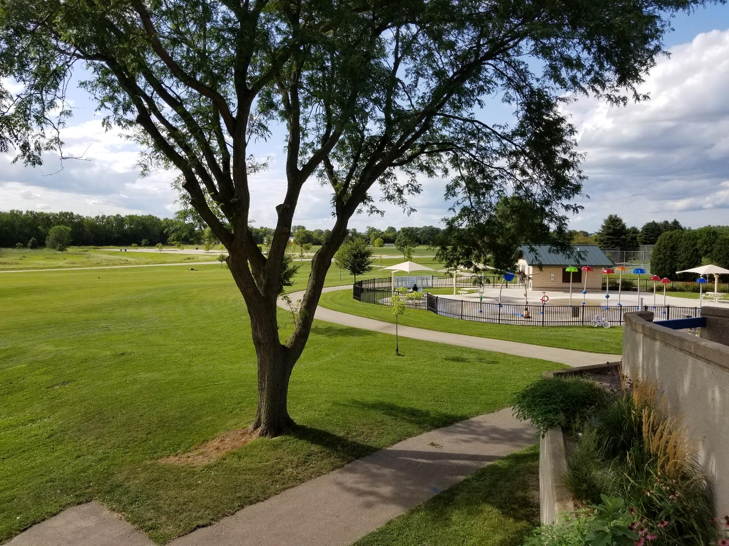

Slide 9
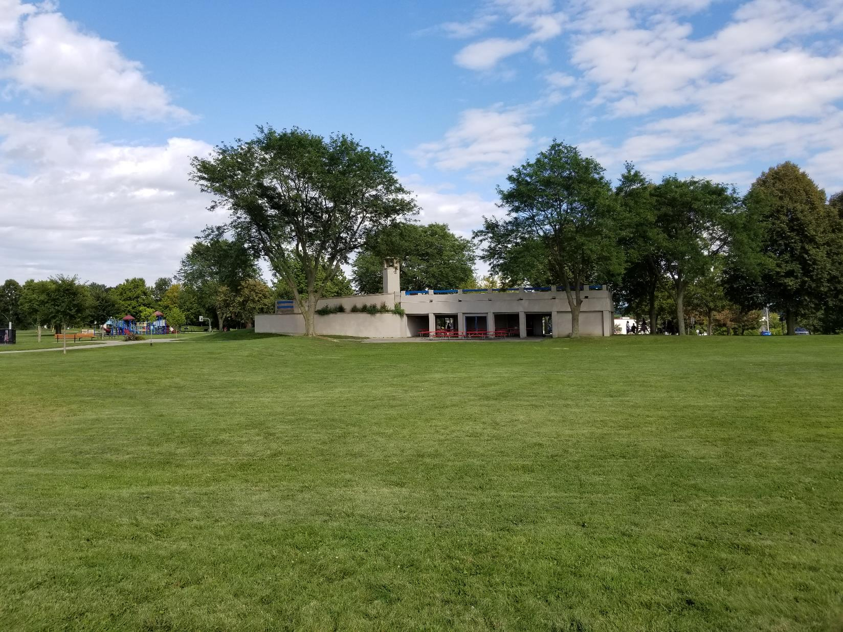

Slide 10
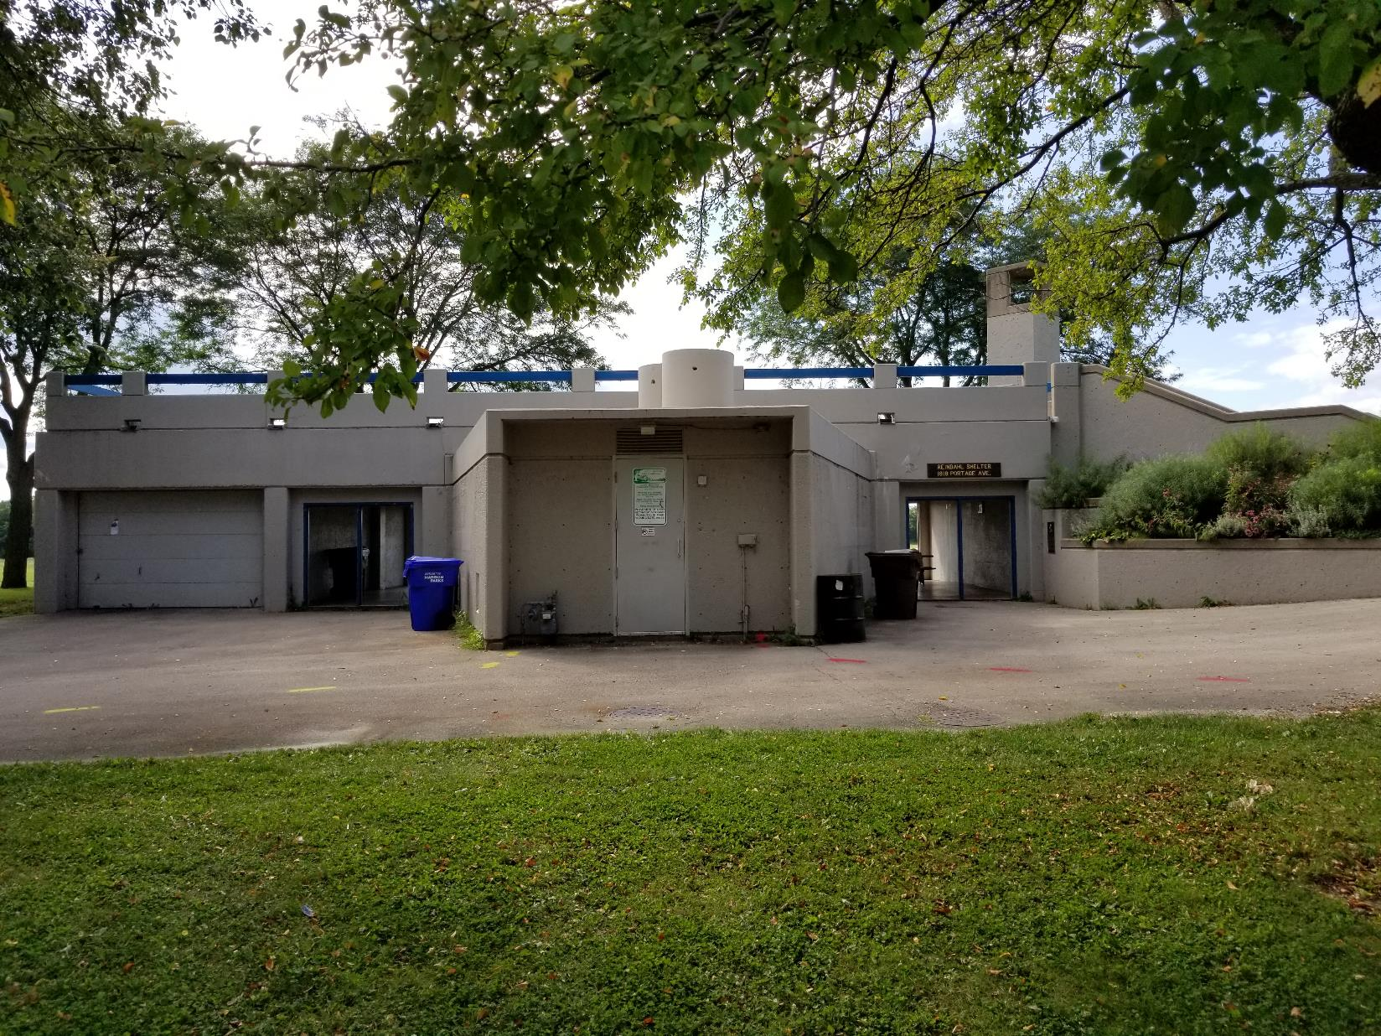

Slide 11
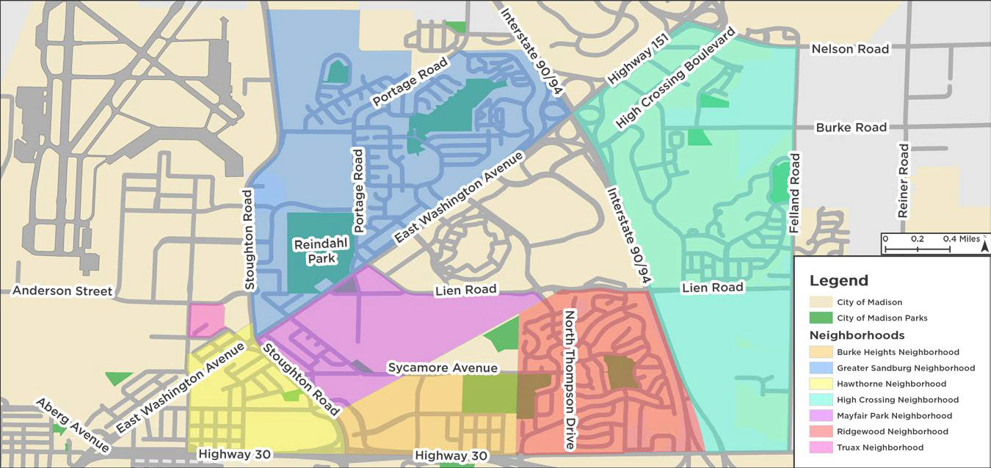
Neighborhoods
Seven Neighborhoods adjacent to Reindahl Park: Burke Heights, Greater Sandburg, Hawthorne, High Crossing, Mayfair Park, Ridgewood, Truax

Slide 12
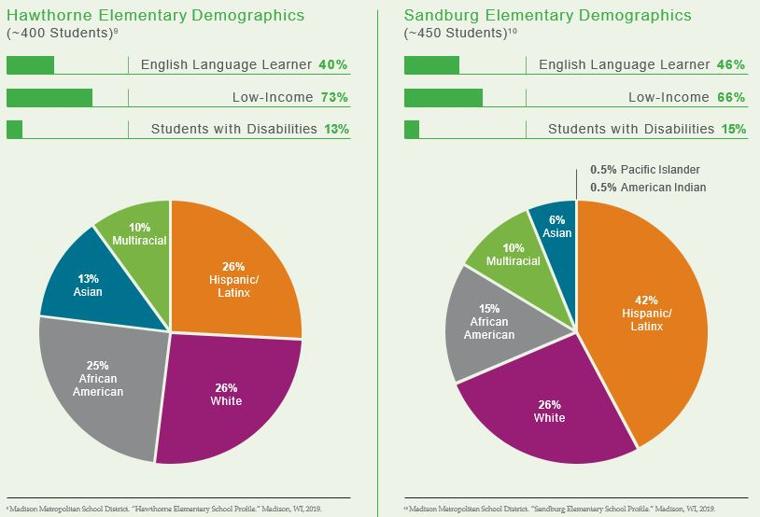
Demographics
Approximately 26,000 residents
Higher percentages of immigrants, youth, and people of color than other areas of Madison
Youth considerably more diverse than the adult population
Adults have lower levels of educational attainment
Approximately 1,500 households without internet access
Data from Madison Metropolitan School District Profiles - 2019

Slide 13
Transportation
Pedestrian network and bike network generally well-suited for access to the Imagination Center
Three Metro Transit stops located adjacent or nearby Reindahl Park. Most notably, there is a stop at Thierer Road and East Washington Avenue
A Bus Rapid Transit stop is planned at Reindahl Park
Accessibility - important consideration for siting the Imagination Center

Slide 14
Bus Rapid Transit
Bus Rapid Transit stop planned for Thierer Road and East Washington Avenue
Great potential to serve Reindahl Park and connect it to downtown and the west side of Madison
Reindahl Park

Slide 15
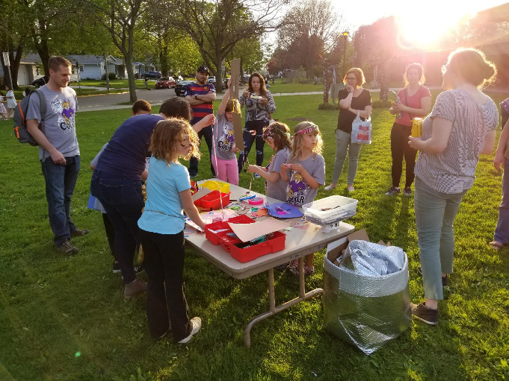
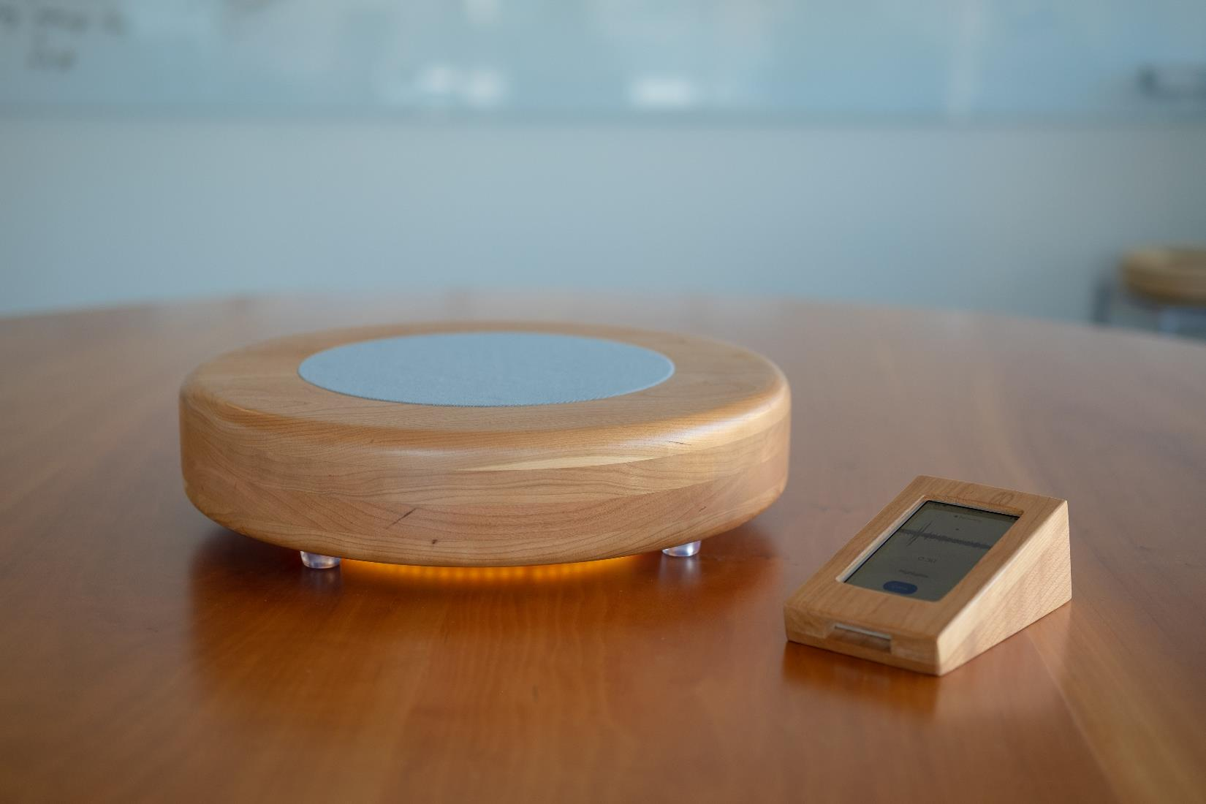
Engagement
October 2018 - October 2019
112 Conversations with 425 Community Members. One-on-one and small group conversations were the primary focus. Attended a variety of existing community events (Wild Rumpus, District 17 Forum, EMCC events)
Engagement sessions at Hawthorne, Sandburg, East and West High Schools (Escalera Program, Book Club, and Principal’s Equity Group)
Local Voices Network

Slide 16
Data Analysis and Recommendation Structure
Gathered notes from each conversation and interaction with community members
Library staff completed a qualitative analysis of the notes and grouped recommendations by the five critical roles established in Communities Inspiring Libraries
South Central Library System – Data Services Consultant ran an anonymized analysis simultaneously for quality control
Recommendations are a result of community conversations, research, and institutional goals

Slide 17
Social Forum
Meeting Rooms
Event and Gathering Space
Food Preparation and Programming
Youth and Teen Space
Anji Play

Slide 18
Social Forum
Meeting Rooms
Event and Gathering Space
Food Preparation Space
The current Reindahl Park shelter is aging and lacks natural light. Community groups host events in the parking lot or lawn areas of the park
Opportunity for meeting rooms, shared event space, and facility co-location
Food preparation space could be used for events and Library/Parks programming

Slide 19
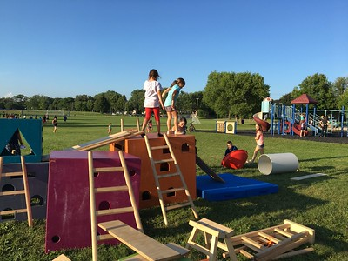
Social Forum
4 Youth and Teen Space
5 Anji Play
Parents often shared desire for more opportunities for youth recreation and learning
Large youth population lives in northeast Madison
Opportunity to expand
Anji Play at Reindahl Park

Slide 20
Civic Innovator
Immigration and Citizenship
Digital Engagement
Polling Place and Voter Registration

Slide 21
Civic Innovator
Immigration and Citizenship
Digital Engagement
Polling Place and Voter Registration
Higher immigrant population than most other areas of Madison. The Imagination Center will have immigration resources and could partner with an organization to offer drop-in assistance
“Virtual City Hall” concept to connect residents to city government, meetings, and services
Polling place and voter registration, other civic discussions and information sharing

Slide 22
Holistic Health Advocate
Health Literacy and Health Services
Environmental Education
Garden and Outdoor Workspace

Slide 23
Holistic Health Advocate
Health Literacy and Health Services
Residents expressed health concerns in their community, especially behavioral health. Opportunity to improve health literacy and offer services such as drop-in clinics
Location at Reindahl Park key to increasing recreational programming and activities

Slide 24
Holistic Health Advocate
2 Environmental Education
3 Garden and Outdoor Workspace
Neighborhood residents are worried about environmental impacts resulting from PFAS, F35’s, and urban development
The Imagination Center’s location at Reindahl Park presents a great opportunity for environmental education
Creating an outdoor space will provide new opportunities for learning and social interaction

Slide 25
Cultural Platform
Artist-in-Residence
Imagination Center Art
Culturally-Representative Material Collection
Media Programming and Digital Creation

Slide 26
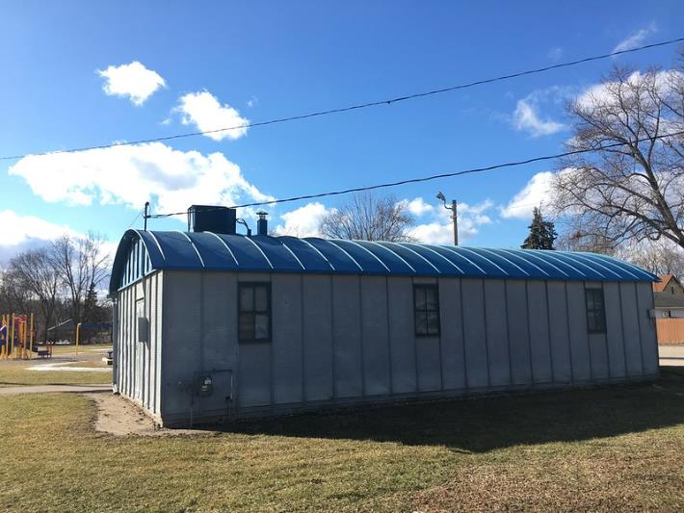
Cultural Platform
Artist-in-Residence
Imagination Center Art
Culturally-Representative Material Collection
Media Programming and Digital Creation
Lack of places for residents to enjoy and create art
Could expand Thurber Park artist-in-residence model to Reindahl Park
Media programming will bring new offerings to northeast Madison

Slide 27
Economic Engine
Digital Inclusion
Child Care
Literacy Classes
Financial Empowerment

Slide 28
Economic Engine
Digital Inclusion
Approximately 1,500 northeast Madison households or 14% of northeast residents do not have internet access in their home or a mobile data plan
Students asked for a place to work on homework after school and on weekends
Imagination Center will provide high-speed internet and related services such as printing, scanning, etc.

Slide 29
Economic Engine
2 Child Care
Many community members described challenges finding child care in the northeast Madison region
The Greater Sandburg Neighborhood is a child care desert according to the Center for American Progress
The youth population in the Reindahl Park area is growing – 20.1% increase from 2010 to 2017
Future residential development planned for East Towne Mall and the east side of I90/94

Slide 30
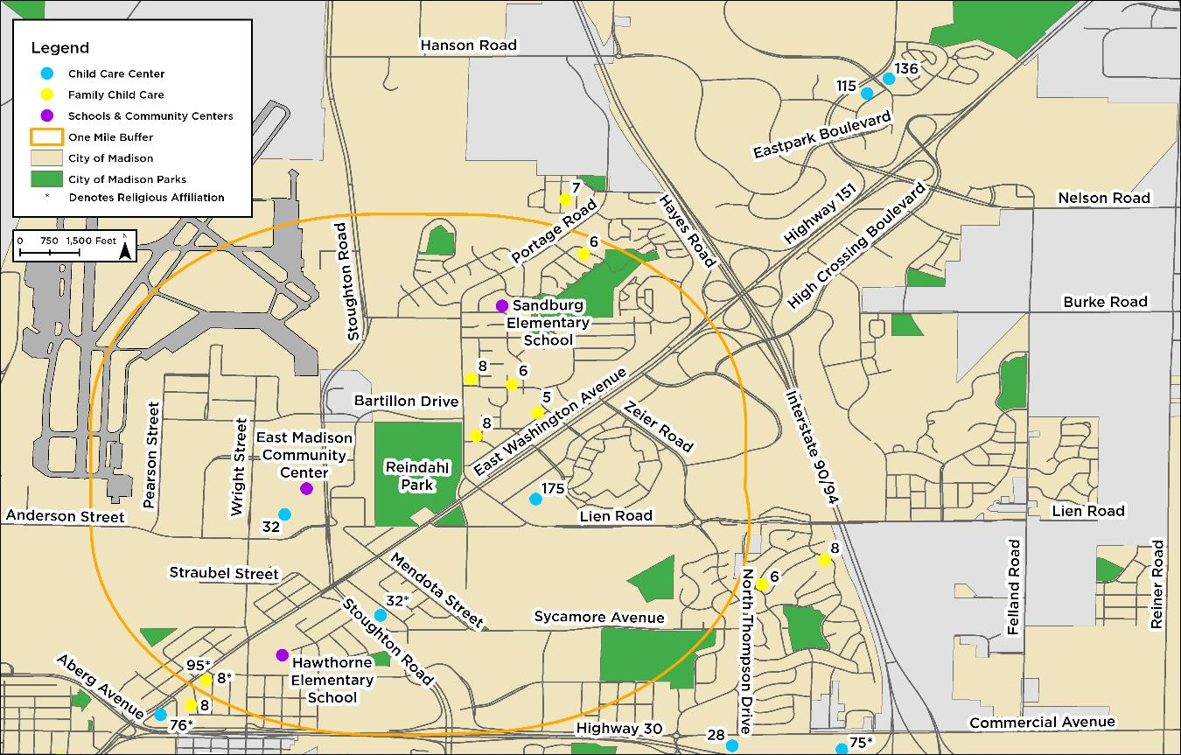
Reindahl Park Area Child Care Centers and Homes

Slide 31
Economic Engine
3 Literacy Classes
4 Financial Empowerment
Strong community interest for literacy classes, especially ESL classes
Imagination Center will provide literacy resources and the Library could expand partnerships with organizations to host literacy classes at the Center
Presence of financial institutions nearby could lead to partnerships aimed at improving financial outcomes for Imagination Center visitors

Slide 32
Imagine Madison and
Park and Open Space Plan
The Imagination Center will advance at least 12 goals from Imagine Madison: City of Madison Comprehensive Plan
Provide opportunities to learn about, create, collaborate, and enjoy the arts
Locate community facilities to provide a high level of service to all neighborhoods
Improve accessibility to government agencies and services
2018-2023 Park and Open Space Plan
Design park facilities to accommodate diverse activities and populations
Increase engagement with groups and organizations and develop new ones

Slide 33
The Road Ahead
Library Board and Board of Park Commissioners approval
Begin pre-design process – further refine the Imagination Center scope, cost estimation, and conceptualize project
Assess fundraising capacity and determine financial model
Form partnerships with community organizations for services such as literacy classes and child care

